Slide 1
Vector Semantics

Slide 2
Why vector models of meaning? computing the similarity between words
“fast” is similar to “rapid”
“tall” is similar to “height”
Question answering:
Q: “How tall is Mt. Everest?” Candidate A: “The official height of Mount Everest is 29029 feet”

Slide 3
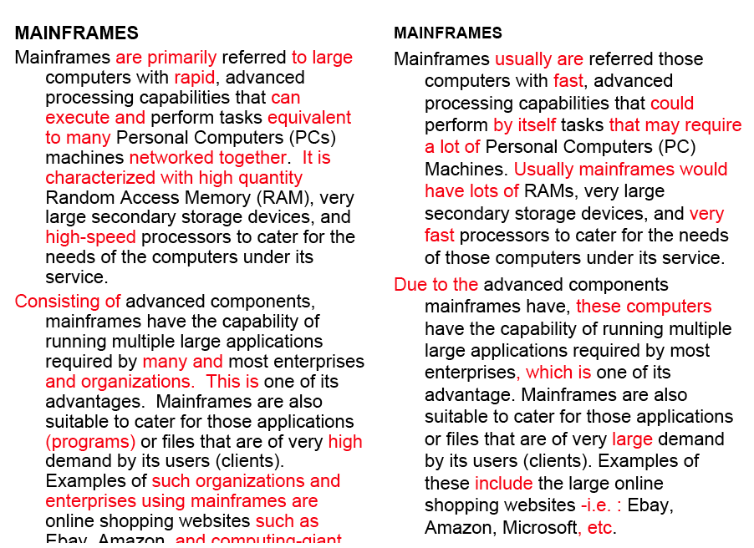
Word similarity for plagiarism detection

Slide 4
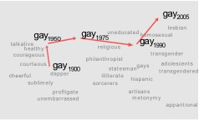
Word similarity for historical linguistics: semantic change over time
Sagi, Kaufmann Clark 2013
Kulkarni, Al-Rfou, Perozzi, Skiena 2015

Slide 5
Distributional models of meaning = vector-space models of meaning = vector semantics
Intuitions: Zellig Harris (1954):
“oculist and eye-doctor … occur in almost the same environments”
“If A and B have almost identical environments we say that they are synonyms.”
Firth (1957):
“You shall know a word by the company it keeps!”

Slide 6
Intuition of distributional word similarity
Nida example:
A bottle of tesgüino is on the table
Everybody likes tesgüino
Tesgüino makes you drunk
We make tesgüino out of corn.
From context words humans can guess tesgüino means
an alcoholic beverage like beer
Intuition for algorithm:
Two words are similar if they have similar word contexts.

Slide 7
Four kinds of vector models
Sparse vector representations
Mutual-information weighted word co-occurrence matrices
Dense vector representations:
Singular value decomposition (and Latent Semantic Analysis)
Neural-network-inspired models (skip-grams, CBOW)
Brown clusters

Slide 8
Shared intuition
Model the meaning of a word by “embedding” in a vector space.
The meaning of a word is a vector of numbers
Vector models are also called “embeddings”.
Contrast: word meaning is represented in many computational linguistic applications by a vocabulary index (“word number 545”)
Old philosophy joke:
Q: What’s the meaning of life?
A: LIFE’

Slide 9
Term-document matrix
Each cell: count of term t in a document d: tf_{t,d}:
Each document is a count vector in ℕ^{v}: a column below

Slide 10
Term-document matrix
Two documents are similar if their vectors are similar

Slide 11
The words in a term-document matrix
Each word is a count vector in ℕ^{D}: a row below

Slide 12
The words in a term-document matrix
Two words are similar if their vectors are similar

Slide 13
Term-context matrix for word similarity
Two words are similar in meaning if their context vectors are similar

Slide 14
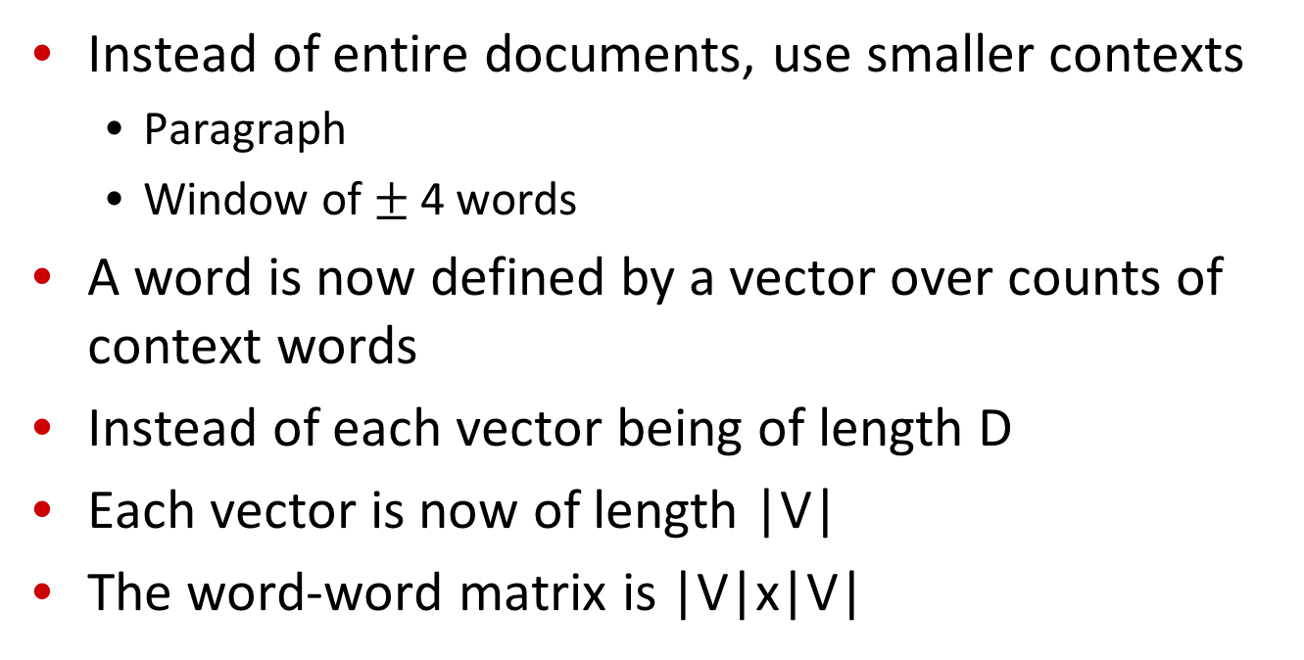
The word-word or word-context matrix
Instead of entire documents, use smaller contexts
Paragraph
Window of $±$ 4 words
A word is now defined by a vector over counts of context words
Instead of each vector being of length D
Each vector is now of length |V|
The word-word matrix is |V|x|V|

Slide 15
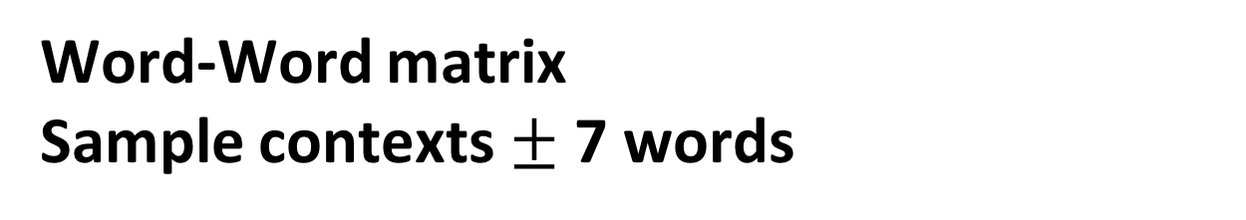
Word-Word matrix Sample contexts $±$ 7 words
…
…

Slide 16
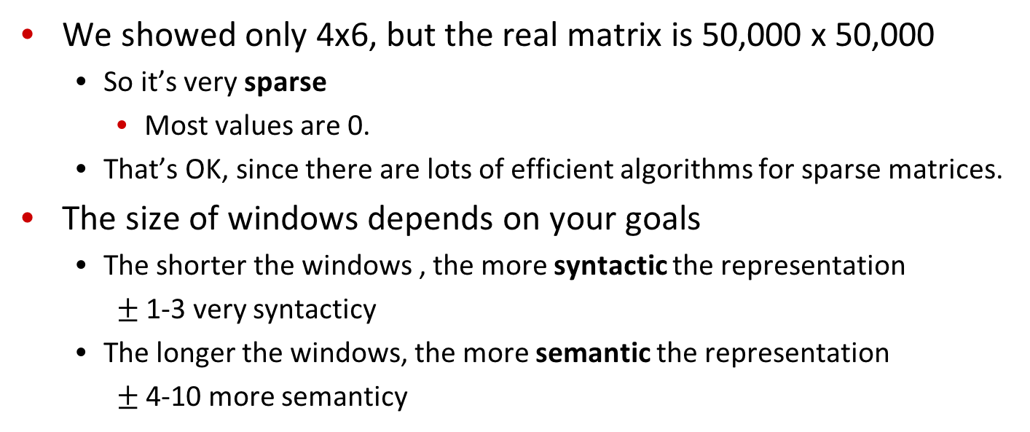
Word-word matrix
We showed only 4x6, but the real matrix is 50,000 x 50,000
So it’s very sparse
Most values are 0.
That’s OK, since there are lots of efficient algorithms for sparse matrices.
The size of windows depends on your goals
The shorter the windows , the more syntactic the representation
$±$ 1-3 very syntacticy
The longer the windows, the more semantic the representation
$±$ 4-10 more semanticy

Slide 17
2 kinds of co-occurrence between 2 words
(Schütze and Pedersen, 1993)
First-order co-occurrence (syntagmatic association):
They are typically nearby each other.
wrote is a first-order associate of book or poem.
Second-order co-occurrence (paradigmatic association):
They have similar neighbors.
wrote is a second- order associate of words like said or remarked.

Slide 18
Vector Semantics
Positive Pointwise Mutual Information (PPMI)

Slide 19
Problem with raw counts
Raw word frequency is not a great measure of association between words
It’s very skewed
“the” and “of” are very frequent, but maybe not the most discriminative
We’d rather have a measure that asks whether a context word is particularly informative about the target word.
Positive Pointwise Mutual Information (PPMI)

Slide 20
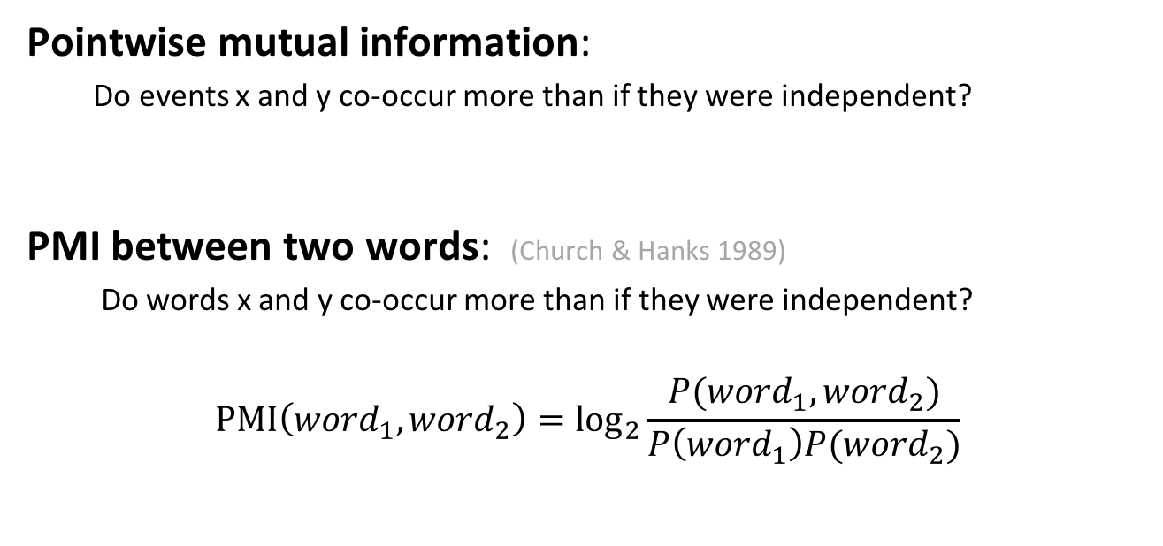
Pointwise Mutual Information
Pointwise mutual information:
Do events x and y co-occur more than if they were independent?
PMI between two words: (Church & Hanks 1989)
Do words x and y co-occur more than if they were independent?
$$\text{PMI}\left({word}_{1}, {word}_{2}\right)={\text{log}}_{2}\frac{P({word}_{1}, {word}_{2})}{P\left({word}_{1}\right)P({word}_{2})}$$

Slide 21
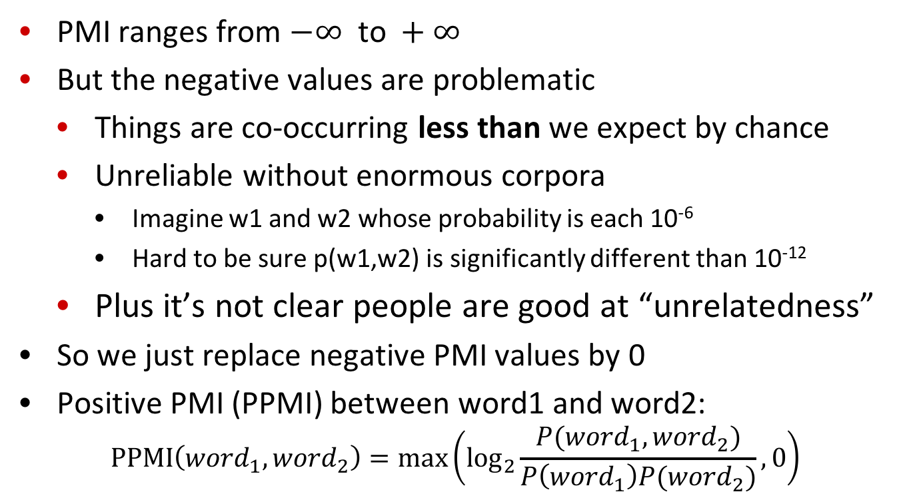
Positive Pointwise Mutual Information
PMI ranges from $−∞ \text{to} +∞$
But the negative values are problematic
Things are co-occurring less than we expect by chance
Unreliable without enormous corpora
Imagine w1 and w2 whose probability is each 10⁻⁶
Hard to be sure p(w1,w2) is significantly different than 10⁻¹²
Plus it’s not clear people are good at “unrelatedness”
So we just replace negative PMI values by 0
Positive PMI (PPMI) between word1 and word2:
$$\text{P}\text{P}\text{MI}\left({word}_{1}, {word}_{2}\right)=\max\left({\text{log}}_{2}\frac{P({word}_{1}, {word}_{2})}{P\left({word}_{1}\right)P({word}_{2})},0\right)$$

Slide 22
Computing PPMI on a term-context matrix
Matrix F with W rows (words) and C columns (contexts)
f_{ij} is # of times w_{i} occurs in context c_{j}

Slide 23
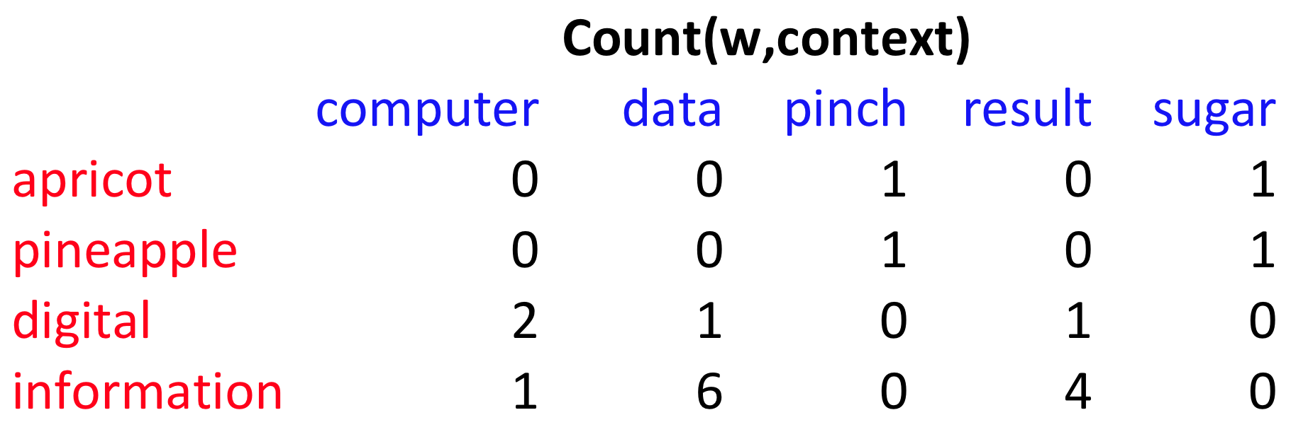
p(w=information,c=data) =
p(w=information) =
p(c=data) =
6/19
= .32
11/19
= .58
7/19
= .37

Slide 24
pmi(information,data) = log₂ (
.32 /
(.37*.58) )
= .58
(.57 using full precision)

Slide 25
Weighting PMI
PMI is biased toward infrequent events
Very rare words have very high PMI values
Two solutions:
Give rare words slightly higher probabilities
Use add-one smoothing (which has a similar effect)

Slide 26
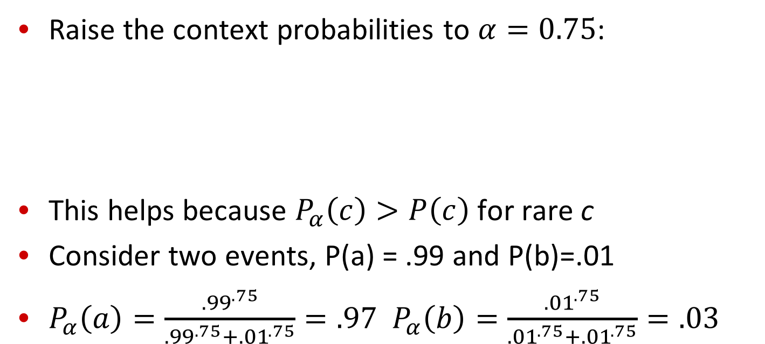
Weighting PMI: Giving rare context words slightly higher probability
Raise the context probabilities to $α=0.75$:
This helps because $P_{α}\left(c\right)>P\left(c\right)$ for rare c
Consider two events, P(a) = .99 and P(b)=.01
$P_{α}\left(a\right)=\frac{{.99}^{.75}}{{.99}^{.75}+{.01}^{.75}}=.97$ $P_{α}\left(b\right)=\frac{{.01}^{.75}}{{.01}^{.75}+{.01}^{.75}}=.03$

Slide 27
Use Laplace (add-1) smoothing

Slide 29
PPMI versus add-2 smoothed PPMI

Slide 30
Vector Semantics
Measuring similarity: the cosine

Slide 31
Measuring similarity
Given 2 target words v and w
We’ll need a way to measure their similarity.
Most measure of vectors similarity are based on the:
Dot product or inner product from linear algebra
High when two vectors have large values in same dimensions.
Low (in fact 0) for orthogonal vectors with zeros in complementary distribution

Slide 32
Problem with dot product
Dot product is longer if the vector is longer. Vector length:
Vectors are longer if they have higher values in each dimension
That means more frequent words will have higher dot products
That’s bad: we don’t want a similarity metric to be sensitive to word frequency

Slide 33
Solution: cosine
Just divide the dot product by the length of the two vectors!
This turns out to be the cosine of the angle between them!

Slide 34
Cosine for computing similarity
Sec. 6.3
Dot product
Unit vectors
v_{i} is the PPMI value for word v in context i
w_{i} is the PPMI value for word w in context i.
Cos(v,w) is the cosine similarity of v and w

Slide 35
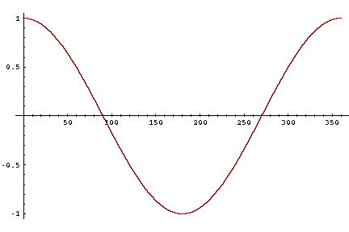
Cosine as a similarity metric
-1: vectors point in opposite directions
+1: vectors point in same directions
0: vectors are orthogonal
Raw frequency or PPMI are non-negative, so cosine range 0-1

Slide 36
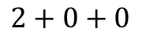
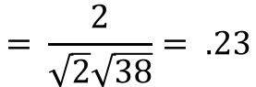
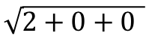
 | large | data | computer
apricot | 2 | 0 | 0
digital | 0 | 1 | 2
information | 1 | 6 | 1
Which pair of words is more similar?
cosine(apricot,information) =
cosine(digital,information) =
cosine(apricot,digital) =
$$2+0+0$$
$$= \frac{2}{\sqrt{2}\sqrt{38}}= .23$$
$$\sqrt{2+0+0 }$$

Slide 37
Visualizing vectors and angles
 | large | data
apricot | 2 | 0
digital | 0 | 1
information | 1 | 6

Slide 38
Clustering vectors to visualize similarity in co-occurrence matrices
Rohde et al. (2006)

Slide 39
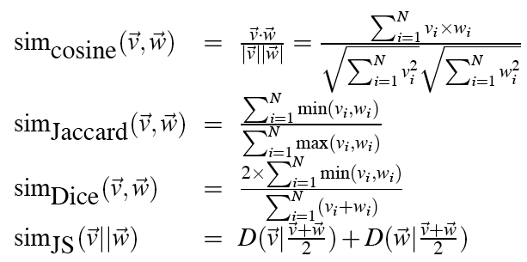
Other possible similarity measures

Slide 40
Vector Semantics
Measuring similarity: the cosine

Slide 41
Using syntax to define a word’s context
Zellig Harris (1968)
“The meaning of entities, and the meaning of grammatical relations among them, is related to the restriction of combinations of these entities relative to other entities”
Two words are similar if they have similar syntactic contexts
Duty and responsibility have similar syntactic distribution:
Modified by adjectives | additional, administrative, assumed, collective, congressional, constitutional …
Objects of verbs | assert, assign, assume, attend to, avoid, become, breach..

Slide 42
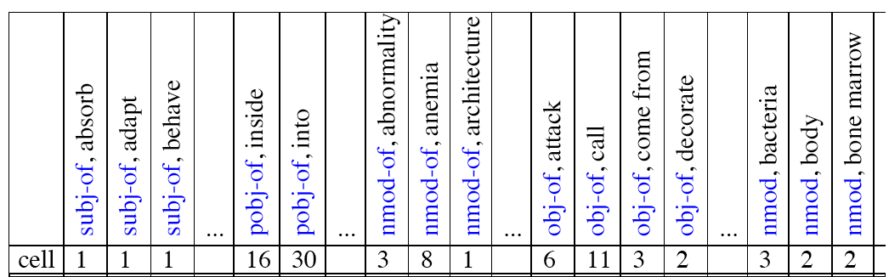
Co-occurrence vectors based on syntactic dependencies
Dekang Lin, 1998 “Automatic Retrieval and Clustering of Similar Words”
Each dimension: a context word in one of R grammatical relations
Subject-of- “absorb”
Instead of a vector of |V| features, a vector of R|V|
Example: counts for the word cell :

Slide 43
Syntactic dependencies for dimensions
Alternative (Padó and Lapata 2007):
Instead of having a |V| x R|V| matrix
Have a |V| x |V| matrix
But the co-occurrence counts aren’t just counts of words in a window
But counts of words that occur in one of R dependencies (subject, object, etc).
So M(“cell”,”absorb”) = count(subj(cell,absorb)) + count(obj(cell,absorb)) + count(pobj(cell,absorb)), etc.

Slide 44
PMI applied to dependency relations
Hindle, Don. 1990. Noun Classification from Predicate-Argument Structure. ACL
Object of “drink” | Count | PMI
it | 3 | 1.3
anything | 3 | 5.2
wine | 2 | 9.3
tea | 2 | 11.8
liquid | 2 | 10.5
Object of “drink” | Count | PMI
tea | 2 | 11.8
liquid | 2 | 10.5
wine | 2 | 9.3
anything | 3 | 5.2
it | 3 | 1.3
“Drink it” more common than “drink wine”
But “wine” is a better “drinkable” thing than “it”

Slide 45
Alternative to PPMI for measuring association
tf-idf (that’s a hyphen not a minus sign)
The combination of two factors
Term frequency (Luhn 1957): frequency of the word (can be logged)
Inverse document frequency (IDF) (Sparck Jones 1972)
N is the total number of documents
df_{i} = “document frequency of word i”
= # of documents with word I
w_{ij} = word i in document j
w_{ij}=tf_{ij} idf_{i}

Slide 46
tf-idf not generally used for word-word similarity
But is by far the most common weighting when we are considering the relationship of words to documents

Slide 47
Vector Semantics
Evaluating similarity

Slide 48
Evaluating similarity
Extrinsic (task-based, end-to-end) Evaluation:
Question Answering
Spell Checking
Essay grading
Intrinsic Evaluation:
Correlation between algorithm and human word similarity ratings
Wordsim353: 353 noun pairs rated 0-10. sim(plane,car)=5.77
Taking TOEFL multiple-choice vocabulary tests
Levied is closest in meaning to:
imposed, believed, requested, correlated

Slide 49
Summary
Distributional (vector) models of meaning
Sparse (PPMI-weighted word-word co-occurrence matrices)
Dense:
Word-word SVD 50-2000 dimensions
Skip-grams and CBOW
Brown clusters 5-20 binary dimensions.

